Slide 1

Creating Brand Equity

Slide 2
Steps in Brand Management
Identifying and establishing brand positioning
Planning and implementing brand marketing
Measuring and interpreting brand performance
Growing and sustaining brand value

Slide 3
Advantages of Strong Brands
Improved perceptions of product performance
Greater loyalty
Less vulnerability to competitive marketing actions
Less vulnerability to crises
Larger margins
More inelastic consumer response
Greater trade cooperation
Increased marketing communications effectiveness
Possible licensing opportunities

Slide 4
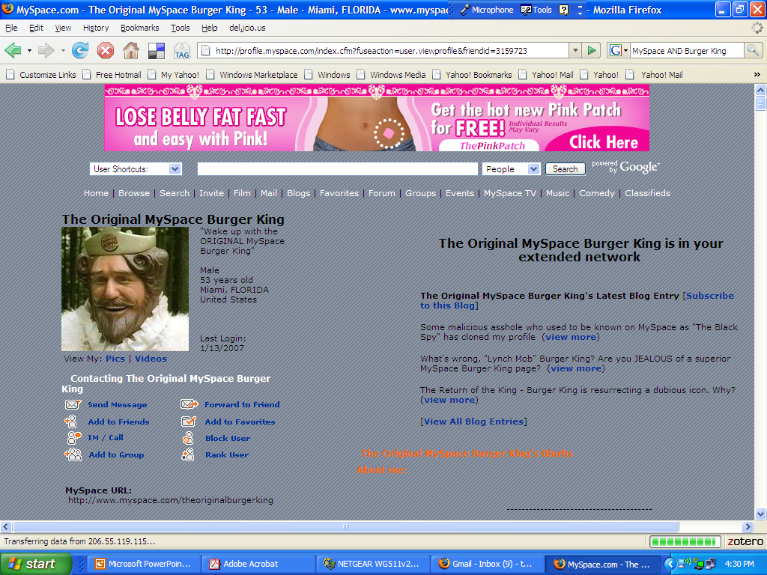
Burger King Builds Its Brand with Social Connectivity

Slide 5
Brand Dynamics Pyramid
Strong Relationship
Bonding
Advantage
Performance
Relevance
Presence
Weak Relationship

Slide 6
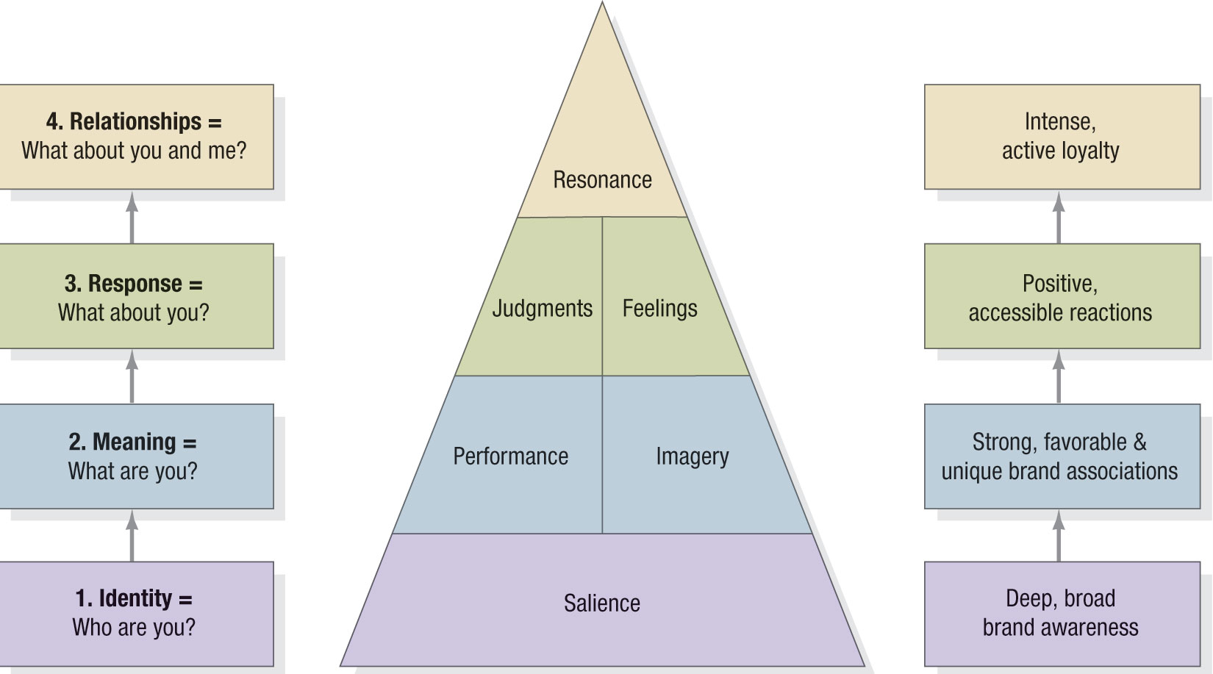
Brand Resonance Pyramid

Slide 7
Brand Elements
Brand
names
URLs
Slogans
Elements
Logos
Characters
Symbols

Slide 8

Brand Element Choice Criteria
Memorable
Meaningful
Likeability
Transferable
Adaptable
Protectible

Slide 9
Slogans
Like a good neighbor, State Farm is there
Just do it
Nothing runs like a Deere
Save 15% or more in 15 minutes or less
Have It Your Way
We Bring Good Things to Life
We try harder
We’ll pick you up
Nextel – Done
Zoom Zoom
I’m lovin’ it
Innovation at work
This Bud’s for you
Always low prices

Slide 10
Examples of effective brand positioning:
Coca-Cola: Coca-Cola has positioned itself as a brand representing happiness, refreshment, and nostalgia. The company’s iconic logo and its association with positive imagery have made it one of the most recognizable brands in the world. Coca-Cola’s marketing campaigns often focus on sharing and connecting with others, reinforcing its association with positive emotions.
Apple: Apple has consistently positioned itself as a premium brand that offers innovative and high-quality products. The company’s sleek designs, cutting-edge technology, and focus on user experience have made it a favorite among tech-savvy consumers.
Nike: Nike has positioned itself as a brand that inspires and empowers athletes of all levels. The company’s “Just Do It” tagline has become a global symbol of motivation and perseverance. Nike’s focus on performance and innovation has made it a leader in the athletic apparel industry.

Slide 11
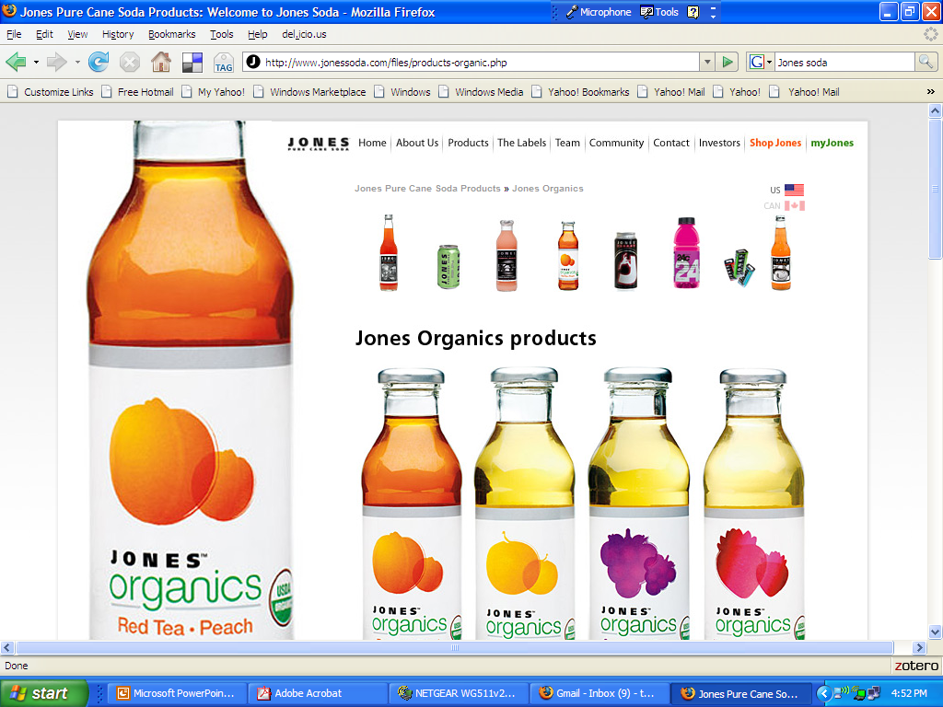
Designing Holistic Marketing Activities
Personalization
Integration
Internalization

Slide 12
The 10 Most Valuable Brands
Brand | Brand Value (Billions)
Coca-Cola | $67.00
Microsoft | $56.93
IBM | $56.20
GE | $48.91
Intel | $38.32
Toyota | $27.94
McDonald’s | $27.50
Mercedes-Benz | $22.13

Slide 13
Interbrand’s Steps in Calculating Brand Equity
Market segmentation
Financial analysis
Role of branding
Brand strength
Brand value calculation

Slide 14

Devising a Branding Strategy
Develop new brand elements
Apply existing brand elements
Use a combination of
old and new

Slide 15

Brand Naming
Individual names
Blanket family names
Separate family names
Corporate name-individual name combo

Slide 16
Brand Roles in a Brand Portfolio
Flankers
Cash Cows
Low-end
Entry-level
High-end
Prestige

Slide 17
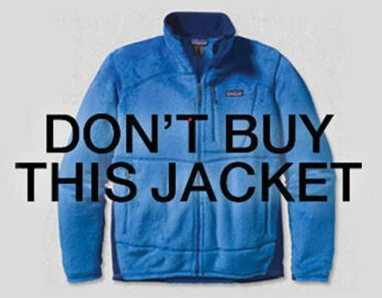

Slide 18
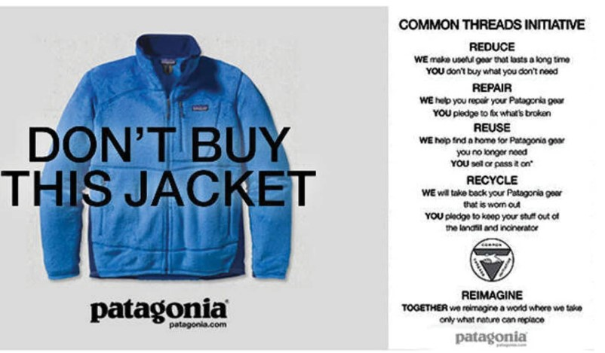
Patagonia's 'Don't buy this jacket' ad.
Patagonias’ Brand Positioning?
For individuals who want outdoor clothing and gear that is durable, sustainable, and ethically made, Patagonia is the leading brand that emphasizes environmental and social responsibility.

Slide 19
A few years ago, they were trying to figure out how to handle Black Friday. They launched a campaign encouraging their consumers not to buy a new Patagonia jacket. Ok, now that’s crazy.
Why? Everything they make takes something from the planet we can’t give back. Each piece of Patagonia clothing, whether or not it’s organic or uses recycled materials, emits several times its weight in greenhouse gases, generates at least another half garment’s worth of scrap, and draws down copious amounts of freshwater now growing scarce everywhere on the planet.
The Patagonia case study is highlighted with an ad in the New York Times asking people to buy less on Black Friday. Yes, they are in business to make and sell products. Yes, they need to make money, and they are growing. But they want to make sure they address the risks of consumerism and don’t want to show up hypocritical.

Slide 20
The company's slogan "Don't buy this jacket" reflects this positioning and emphasizes the brand's focus on promoting conservation and minimizing the impact of consumption on the environment.
To support this positioning, Patagonia has invested heavily in sustainable business practices and materials, such as using organic cotton and recycled polyester in their clothing, implementing a comprehensive environmental strategy that includes reducing their carbon footprint, and promoting fair labor practices.

